Slide 1
Project - Toy Applicant Tracking System
Sneha S

Slide 2
Scope Of The Project
A Recruiter creates and maintains job listings.
A candidate can view all the job listings and apply for a job that he is interested in.
Build the front end (using Python) and the rest-API backend for this minimal functionality.
Use hard coded users for recruiter and candidate - No need to implement authentication
Recruiter - recruiter@screel.in
Candidate - candidate@screel.in
Frontend should have the below screens
List Jobs
CRUD Job
Apply Job

Slide 3
Modules Of The Project
Login → Login module allows valid user (Candidate/ Recruiter) to login by checking the credentials.
Recruiter → Recruiter module allows recruiter have privileges to create the Job Table if it is not exists. Also allows to update/insert and delete the records in the Job Table and it show the list of all recodes available in the Job Table and the Applicant Table.
Candidate → Candidate module allows candidate to view the list of opening jobs of the organization in the main window by just login with his/her credentials.
Technologies Used
Front End: Python
Back End: MYSQL

Slide 4
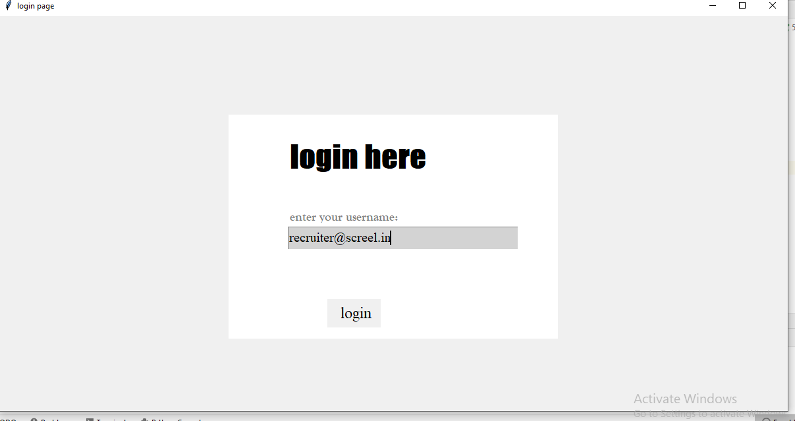
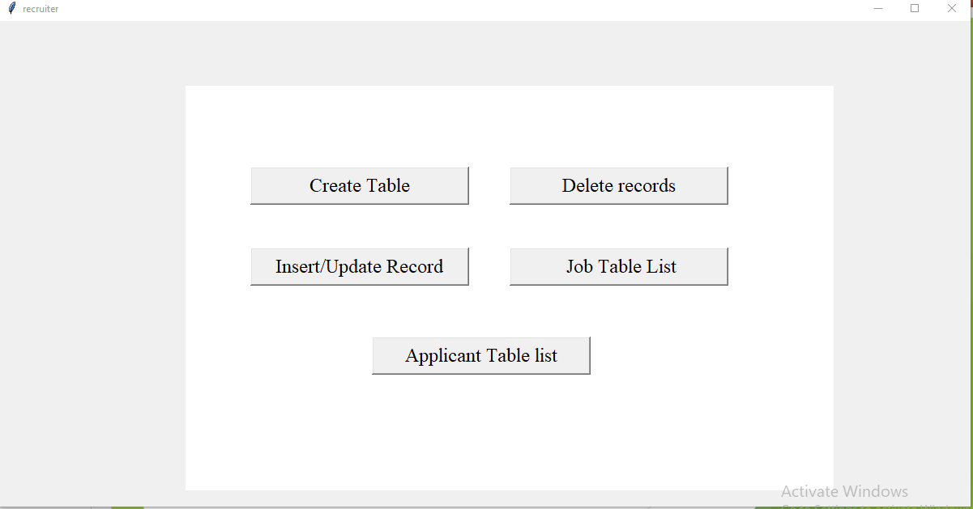
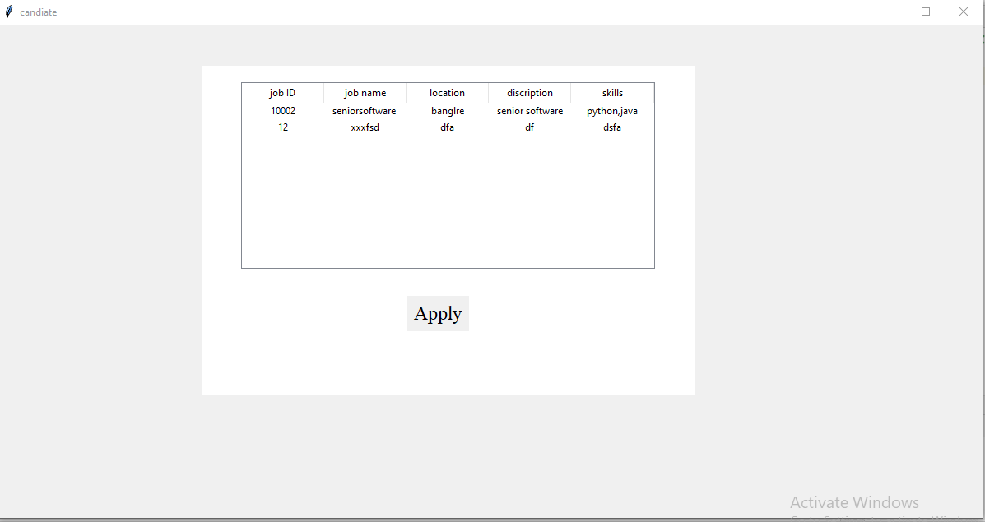
Application View(Front End View)
Authentication Window
Authentication Window
Recruiter Window
Candidate Window
Recruiter Window
Candidate Window

Slide 5
Recruiter Window & Candidate Window
Recruiter Window:
Create Table → Support Recruiter to create Job Table if it is not exists
Delete Records → Use to delete record(s) from Job Table using Job ID.
Insert/Update Record → Allows Recruiter to insert the records to Job Table and update Record if all already exists
Job Table List → It list all the records from Job Table.
Applicant Table List → It list all the records from Application Table.
Candidate Window:
It allows Candidate to view list of jobs available from Job Table and allows to apply available job(s).

Slide 6
Libraries Used In The Project
Tk → Tk provides a library of basic elements of GUI widgets for building a graphical user interface .
Tkinter → Python provides standard library Tkinter for creating the graphical user interface for desktop based application.
Pip →Pip is package-management system used to install and manage software packages.
Fast API→ It enables python program to access MYSQL database

Slide 7
ORM
Job_Table
Application_Table
Job_id
Job_id
first_name
Job_name
last_name
location
Job_name
discription
email_id
It_skills
skills
yearofexp

Slide 8
Non Functional Requirements
User validation →validating which user (recruiter/candidate) is logging in.
Field level validation → Make sure all the fields in the frame are entered, if the fields are not enter then show “Mandatory Fields are missing”.
Record existence validation→ check the record(Job Id) is exist in Job Table while deleting, update and applying for job.
Table existence validation → when Recruiter want to create Job Table, check the table is already exists or not in the database. If table is exists message show that “Table already exists” if table is not exists then it create table in database and prompts “Table created”.

Slide 9
Limitations
White spaces are supported for all TextFields in both Application Table and Job Table.
Applicant Table List record cannot be deleted from Front-end.
Auto refresh on Job List is not available if any changes done in back end until the application is reopened post the changes.

Slide 10
THANK YOU

